Slide 1
GROUP-4
CAPSTONE PROJECT
Members:
Gourinandana N
Helna Eldho
Vimal Jose

Slide 2

POSTMAN

Slide 3
INTRODUCTION
Postman is an Application Programming Interface (API) testing tool.
Postman is a simple Graphic User Interface for sending and viewing HTTP requests and responses.
While using Postman, for testing purposes, one doesn't need to write any HTTP client network code. Instead, we build test suites called collections.
Postman has the feature of sending and observing the Hypertext Transfer Protocol (HTTP) requests and responses.
It can build multiple HTTP requests − POST, PUT, GET, DELETE and translate them to code.
It has a graphical user interface (GUI) and can be used in platforms like Linux, Windows and Mac.

Slide 4

CONTENTS
01
02
03
04
05
INSTALLATION
POST REQUEST
GET REQUEST
PUT REQUEST
DELETE REQUEST

Slide 5
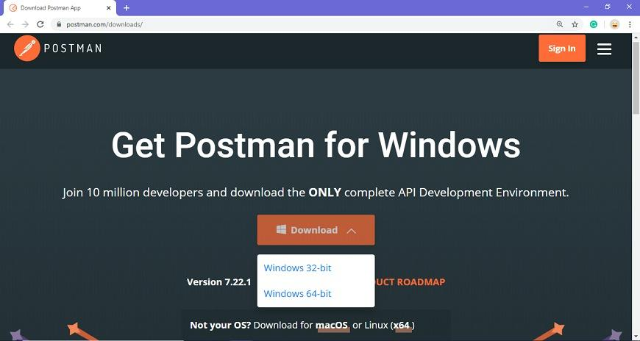
Installation
Go to the link https://www.postman.com/downloads/ and click download for Mac or Windows or Linux based on your operating system.

Slide 6
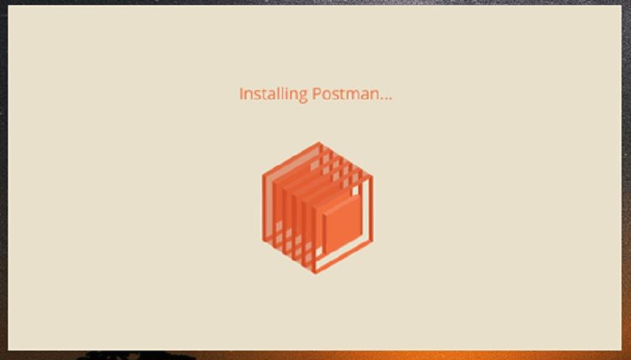
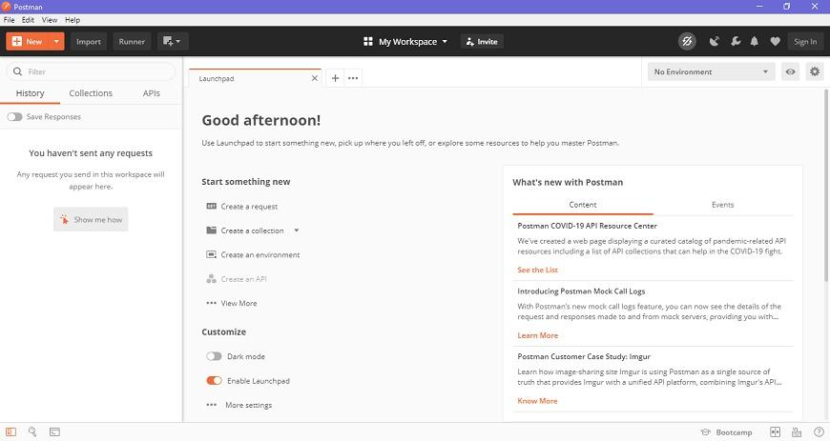
Check the download progress on the bottom left if you are using the Chrome browser. Once the .exe file is downloaded, you need to install the application, as shown in the below image.
Create your account with all the required details and finally you will see the following page, and then you are ready to use Postman.

Slide 7
Post Request
POST request is a method used to add information within the request body in the server.
In general, when we submit a POST request, we expect to have some change on the server, such as updating, removing or inserting.
The POST request is a fundamental method, and this method is mostly used when a user wants to send some sensitive data to the server like to send a form or some confidential data.

Slide 8
Get Request
GET: This HTTP method is used to access the data from an API.
A GET request is used to obtain details from the server and does not have any impact on the server.
The GET request does not update any server data while it is triggered.
Put Request
PUT: This method is used to update the existing data.
It can be used to create a new resource (Depends on API development) if the requested resource is not available

Slide 9
Delete Request
DELETE: This is used to remove or delete the existing data.
DELETE request deletes a resource already present in the server.
The DELETE method sends a request to the server for deleting the request mentioned in the endpoint.
Thus it is capable of updating data on the server.

Slide 10

APPIUM

Slide 11
What is Appium?
Appium is an open-source mobile testing automation tool that is used to test mobile applications.
It is a testing framework for native, hybrid, and web applications.
It supports both simulators (iOS) and emulators (Android) as well as actual devices for automation testing (Android and iOS both).
Appium is similar to Selenium Web driver.
Appium makes mobile app regression testing easy; especially, for large mobile apps that are updated frequently with new features and functionalities.

Slide 12
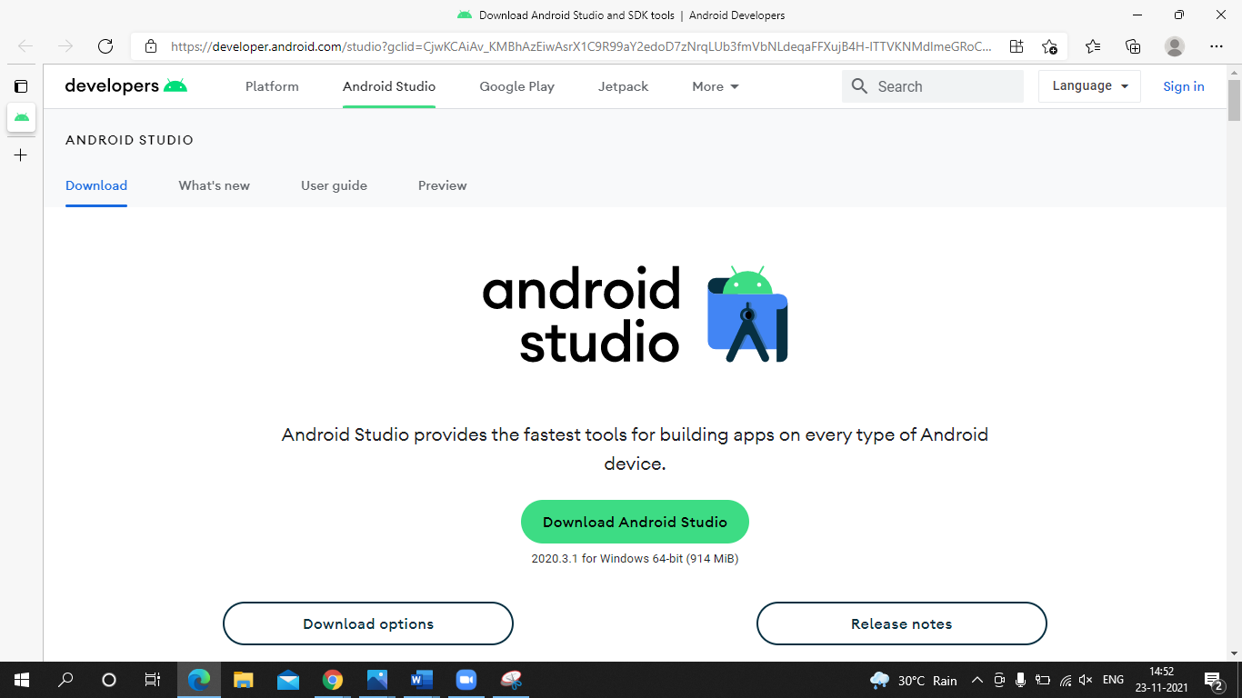
How to setup Appium?
Download Android SDK :-
https://developer.android.com/studio?gclid=CjwKCAiAv_KMBhAzEiwAsrX1C9R99aY2edoD7zNrqLUb3fmVbNLdeqaFFXujB4H-lTTVKNMdlmeGRoCxLUQAvD_BwE&gclsrc=aw.ds

Slide 13
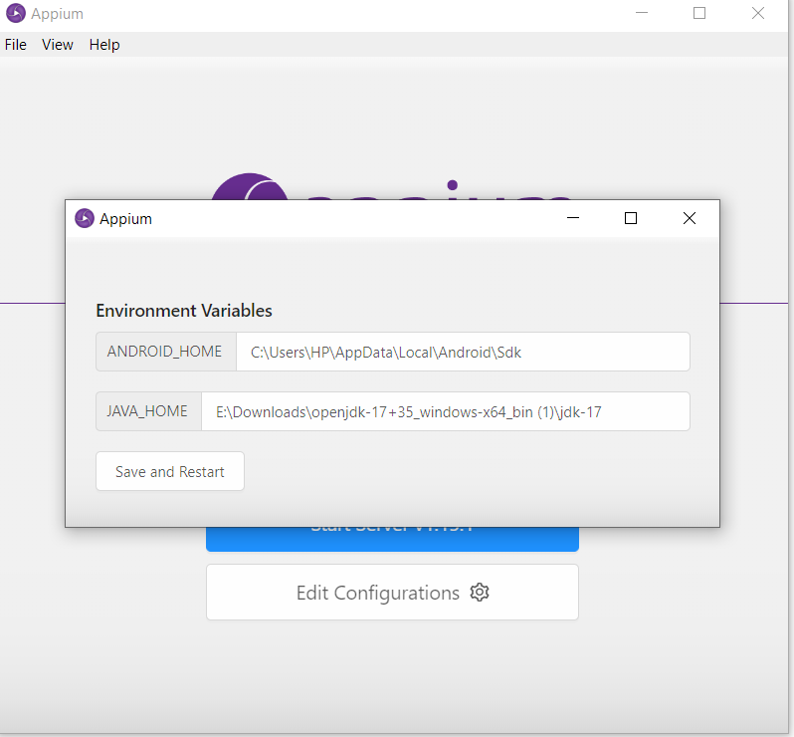
Set Environment Variables

Slide 14
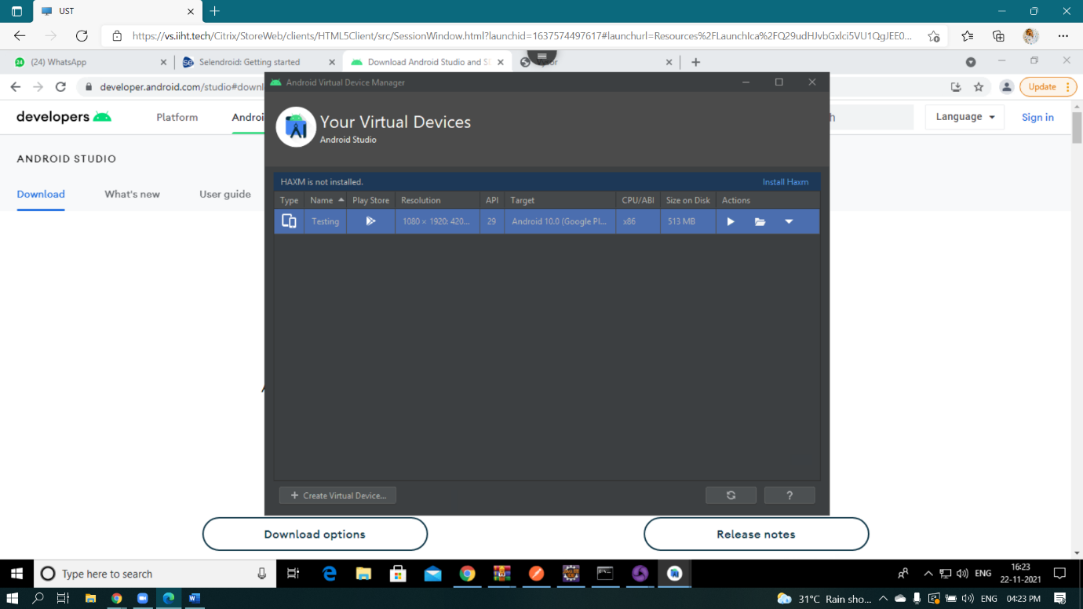
Run the virtual Device

Slide 15
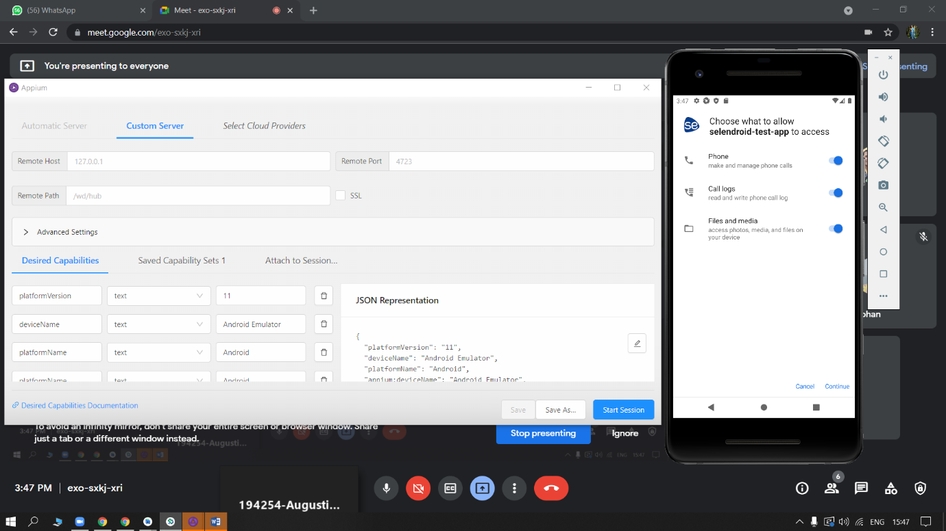
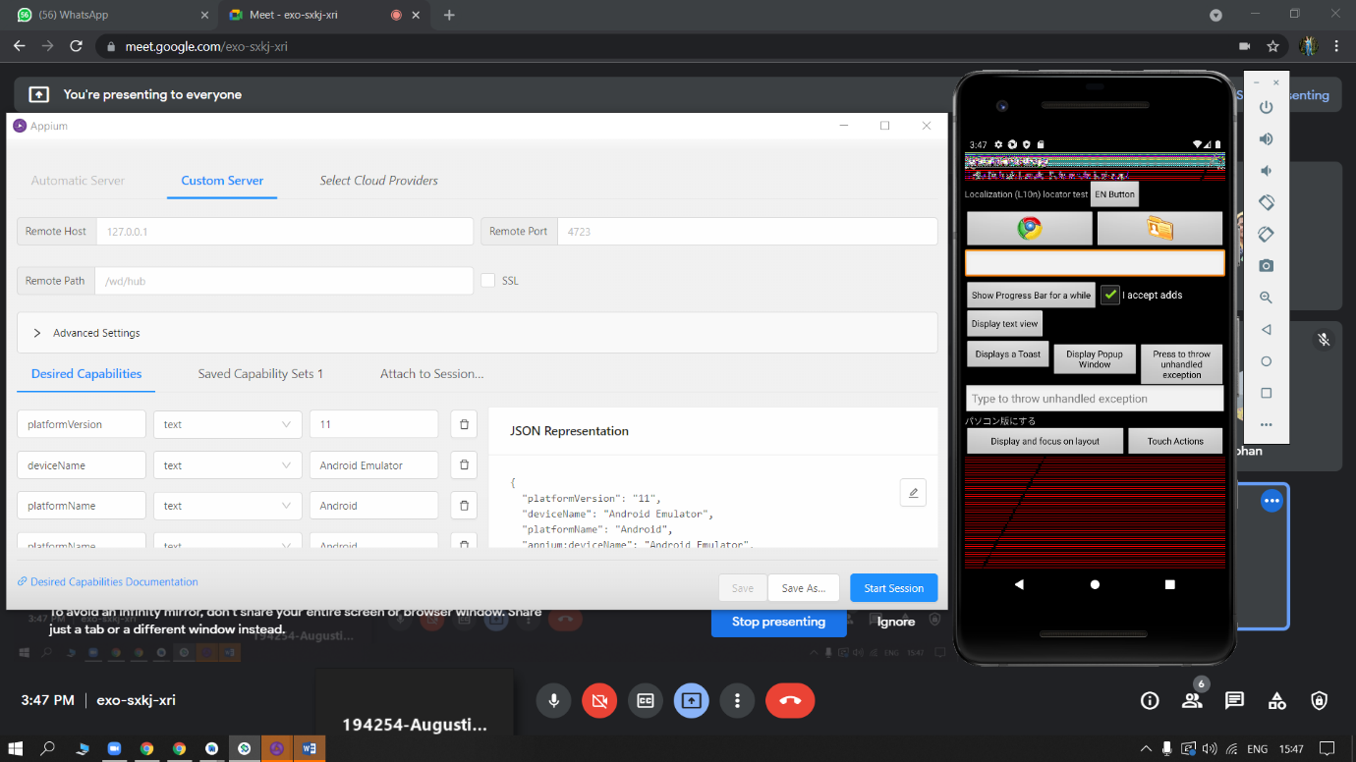

Slide 16
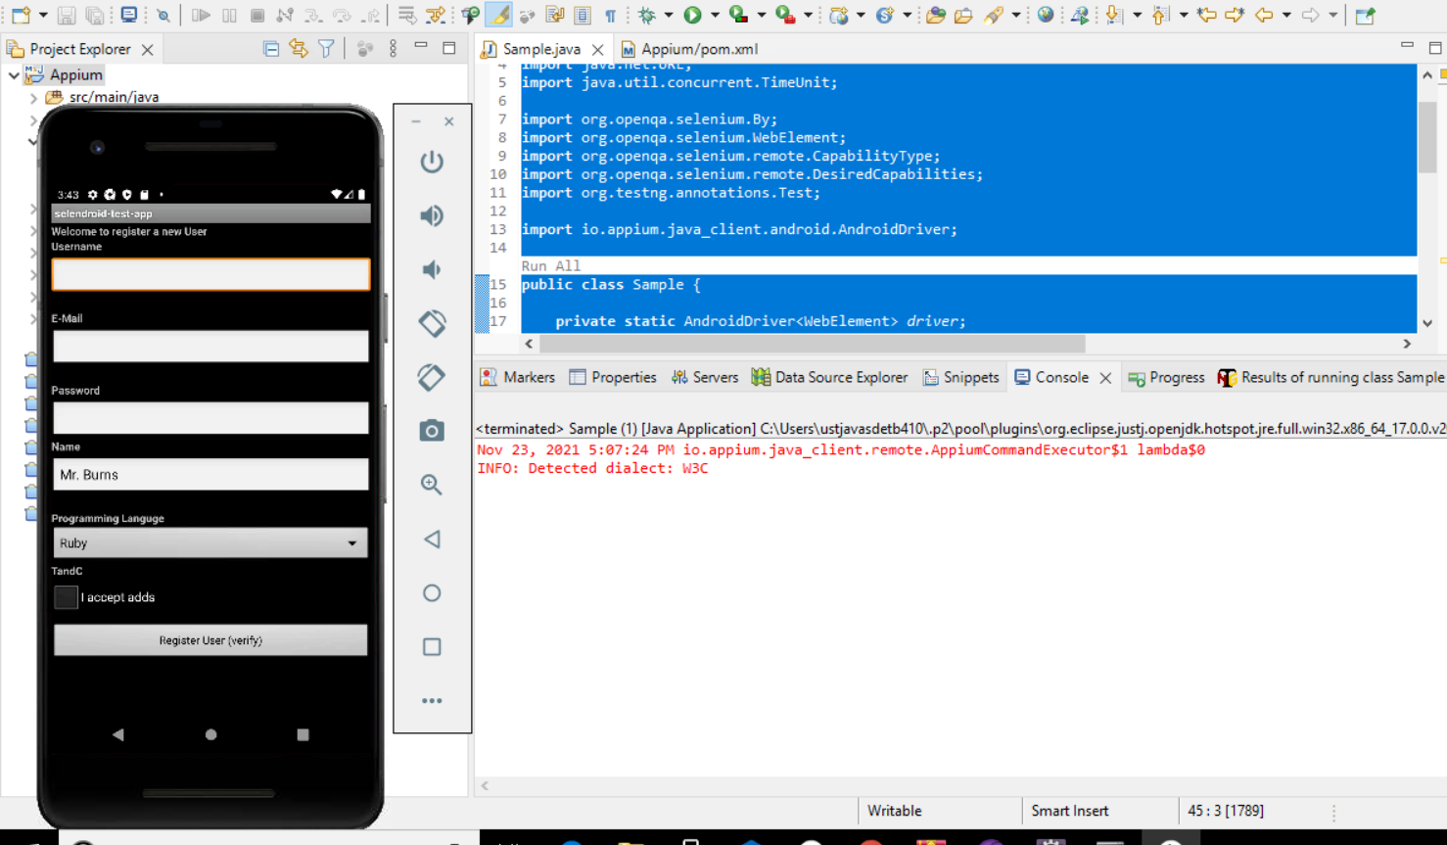
Result Run the code in eclipse and correspondingly view the result in the emulator

Slide 17

JENKINS

Slide 18

Overview
Jenkins is an open source automation server. It helps automate the parts of software development related to building, testing, and deploying, facilitating continuous integration and continuous delivery. It is a server-based system that runs in servlet containers such as Apache Tomcat.

Slide 19
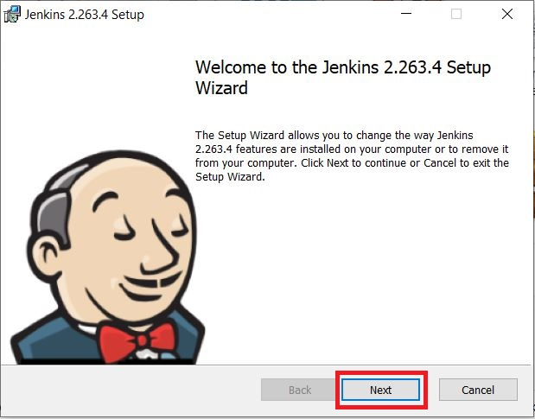
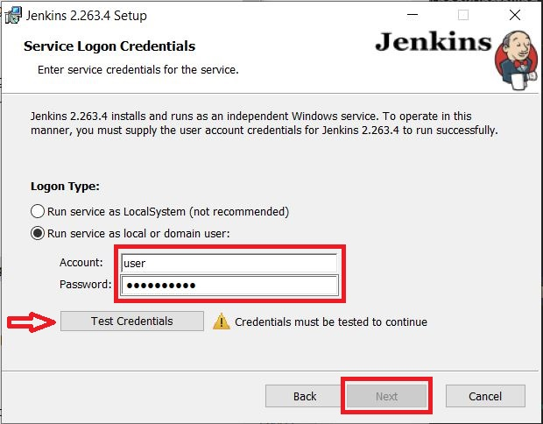
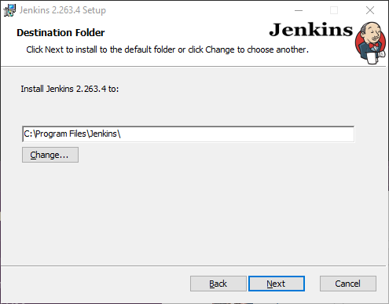
Jenkins Installation
2.Select the destination folder to store your Jenkins Installation and click Next to continue.
01
1.On opening the Windows Installer, an Installation Setup Wizard appears, Click Next on the Setup Wizard to start your installation.
3.To run Jenkins service using a local or domain user, specify the domain user name and password with which you want to run Jenkins, click on Test Credentials to test your domain credentials and click on Next.

Slide 20
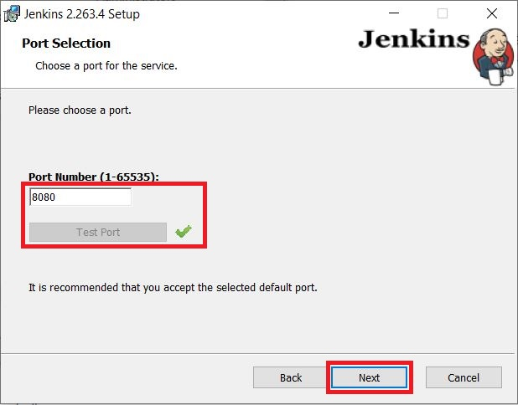
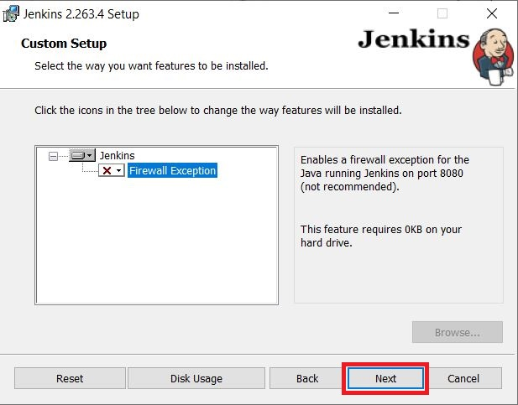
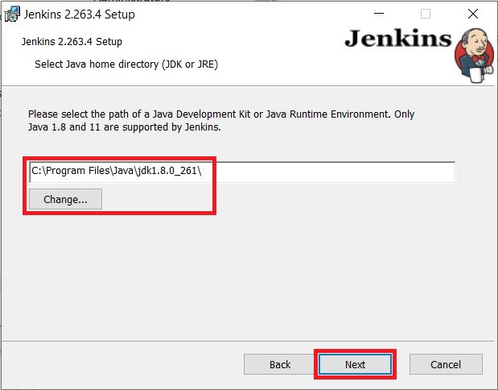
5.The installation process checks for Java on your machine and prefills the dialog with the Java home directory. If the needed Java version is not installed on your machine, you will be prompted to install it.
Once your Java home directory has been selected, click on Next to continue.
01
4.Specify the port on which Jenkins will be running, Test Port button to validate whether the specified port if free on your machine or not. Consequently, if the port is free, it will show a green tick mark as shown above, then click on Next.
6.Select other services that need to be installed with Jenkins and click on Next.

Slide 21
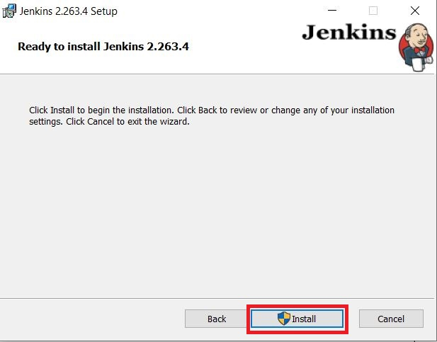
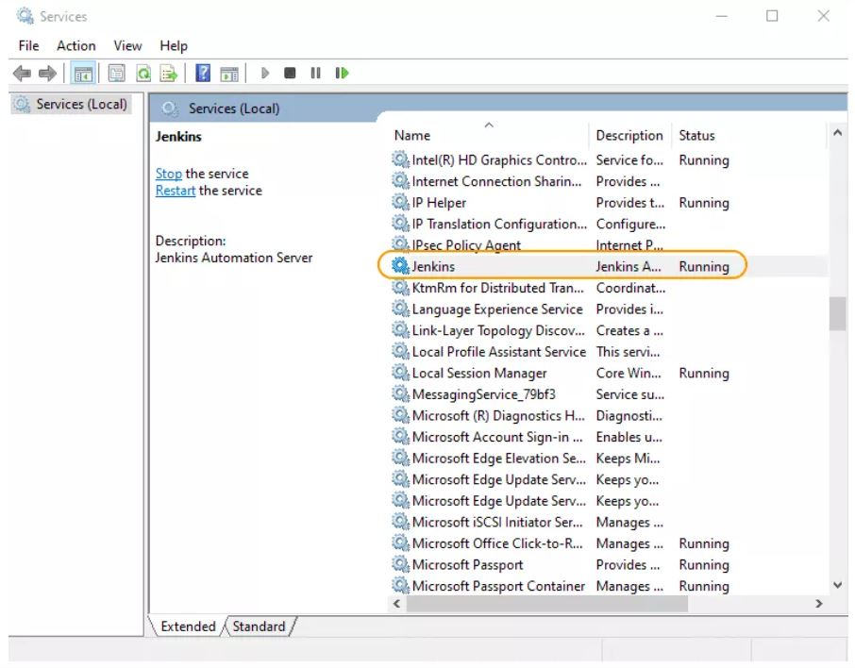
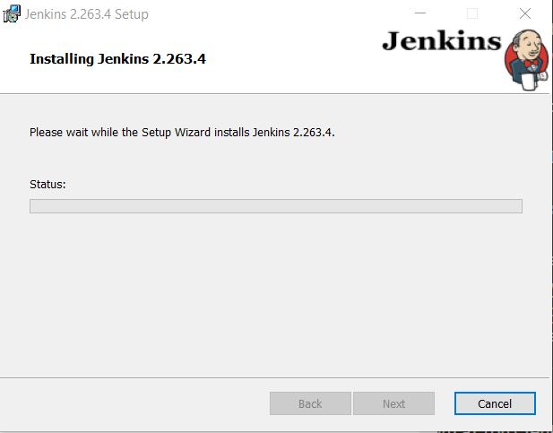
Installation Progress
01
7.Click on the Install button to start the installation of Jenkins.
8.Once the installation completes, click on Finish to complete the installation. Jenkins will be installed as a Windows Service. You can validate this by browsing the services section, as shown above:

Slide 22
Jenkins Implementation
1
Adding Root POM path
2
Setting Configuration
3
Building the project on Jenkins Server

Slide 23
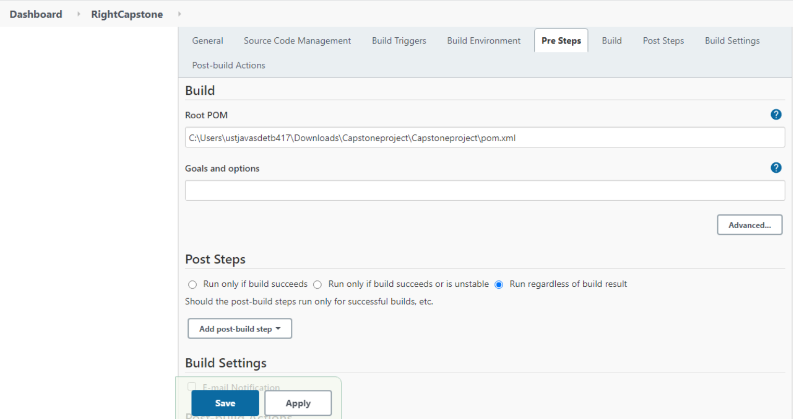
POM ROOT PATH
Take the project Right capstone in the Jenkins.
Click on configure and paste the root of pom file in the build environment.

Slide 24
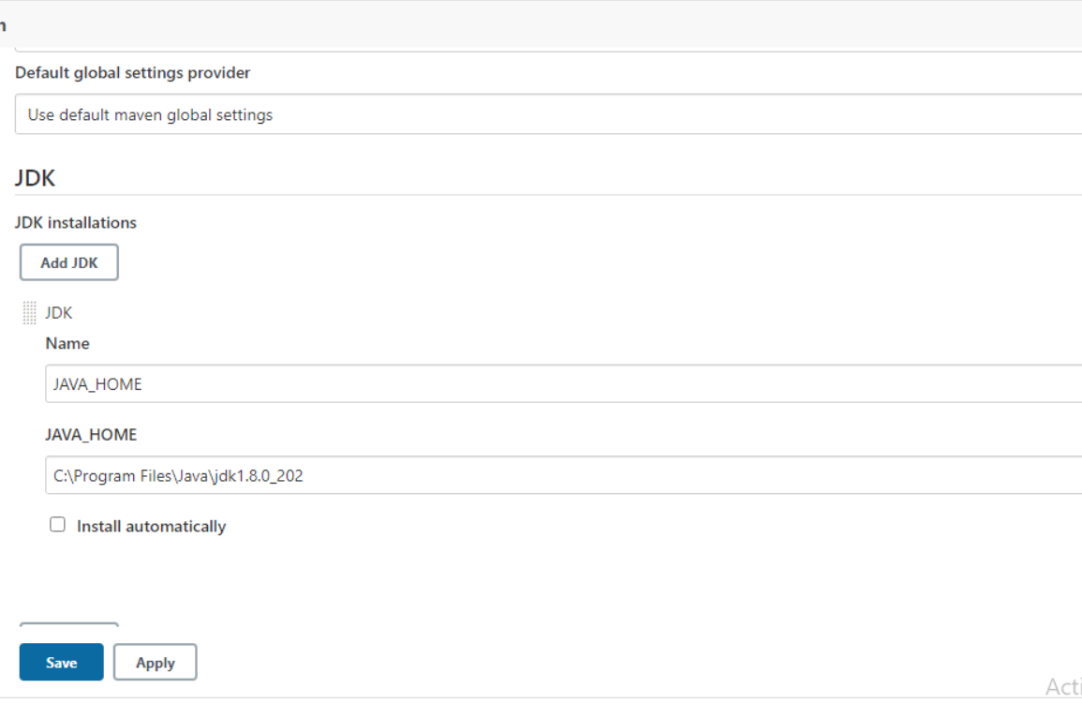
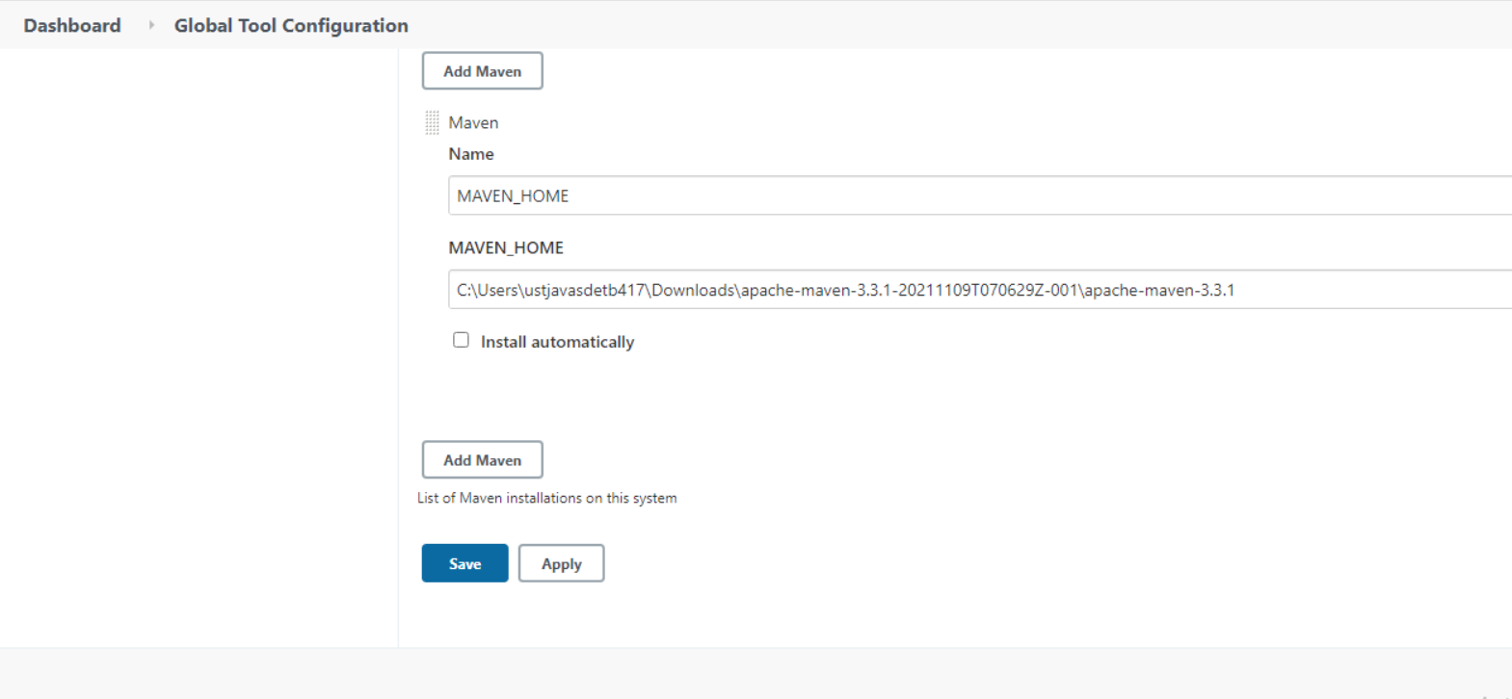
CONFIGURATION
Click on manage Jenkins
Global tool Configuration
Give the JDK Path then, give the path of apache maven 3.3.1
Save and Apply.

Slide 25
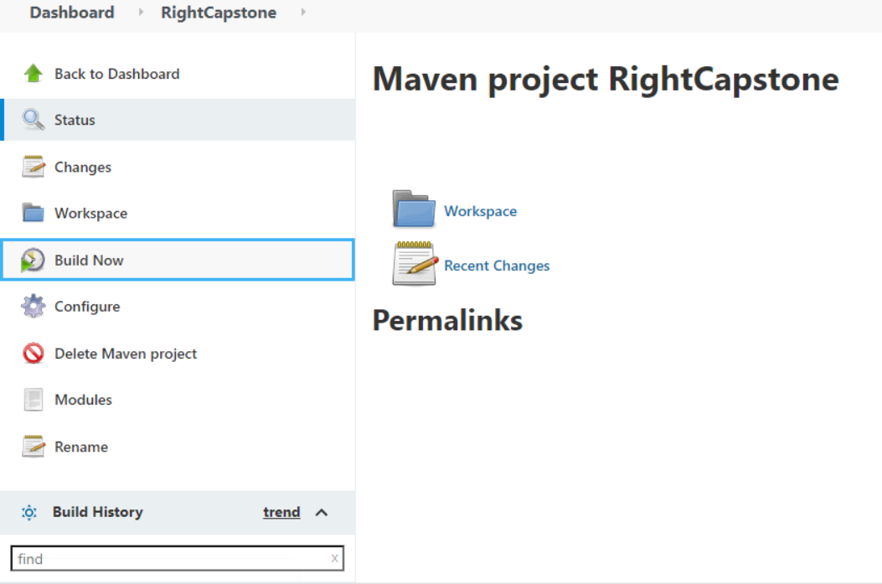
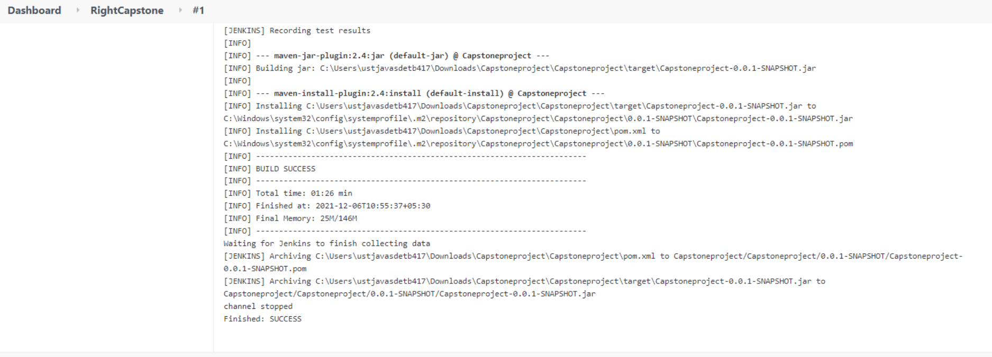
BUILDING PROJECT
Select the project
Build now
Click on the console output.

Slide 26
THANKYOU

